Slide 1

Catalogo de productos

Slide 2
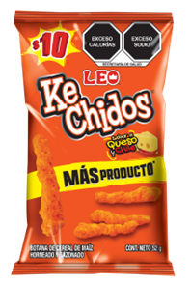
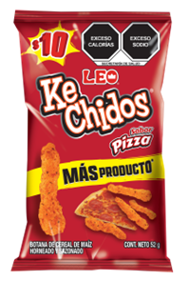
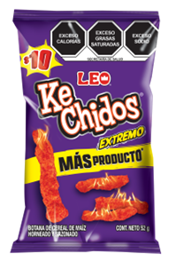
Ke chido
Queso
Ke chido
Pizza
Ke chido
Extremo
48.Grs
$10.11
48.Grs
$10.11
48.Grs
$10.11

Slide 3
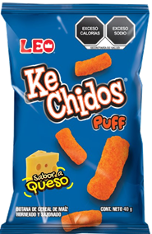
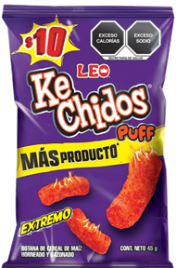
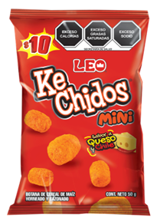
Ke chidos
puff
Ke chidos
Puff extremo
Ke chidos
Mini puff
40.Grs | 150.Grs
$10.11 | $25.27
40.Grs
$10.11
50.Grs
$8.43

Slide 4

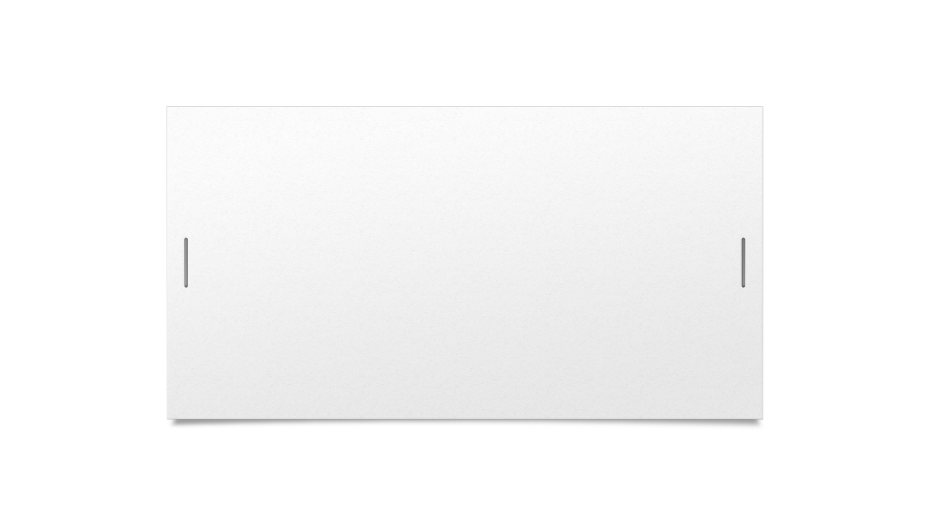

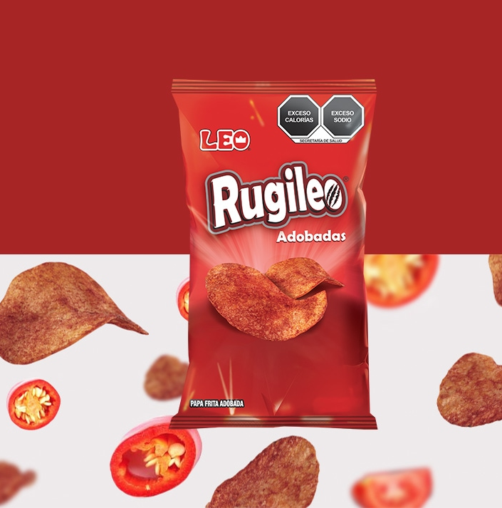
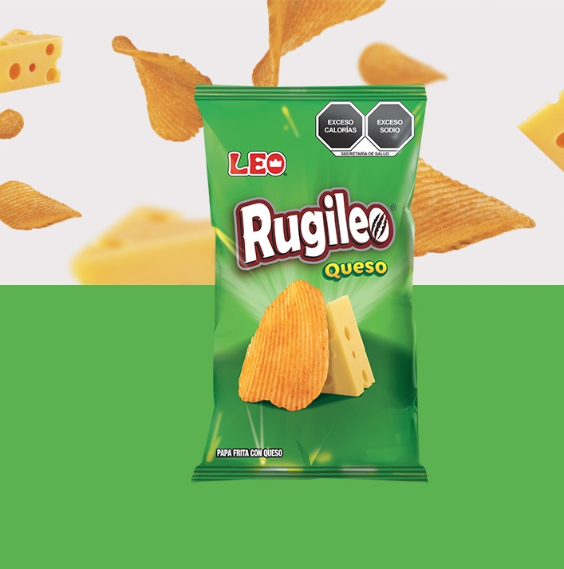
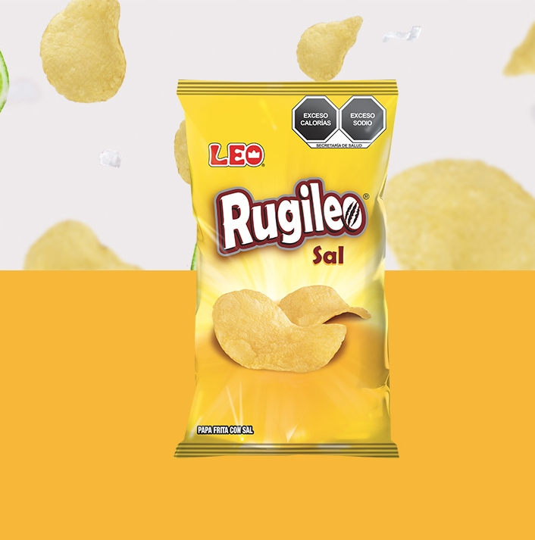


Papa adobada 32.grs | Papa ondulada queso | Papa de sal
$8.43 | $8.43 | $8.43

Slide 5
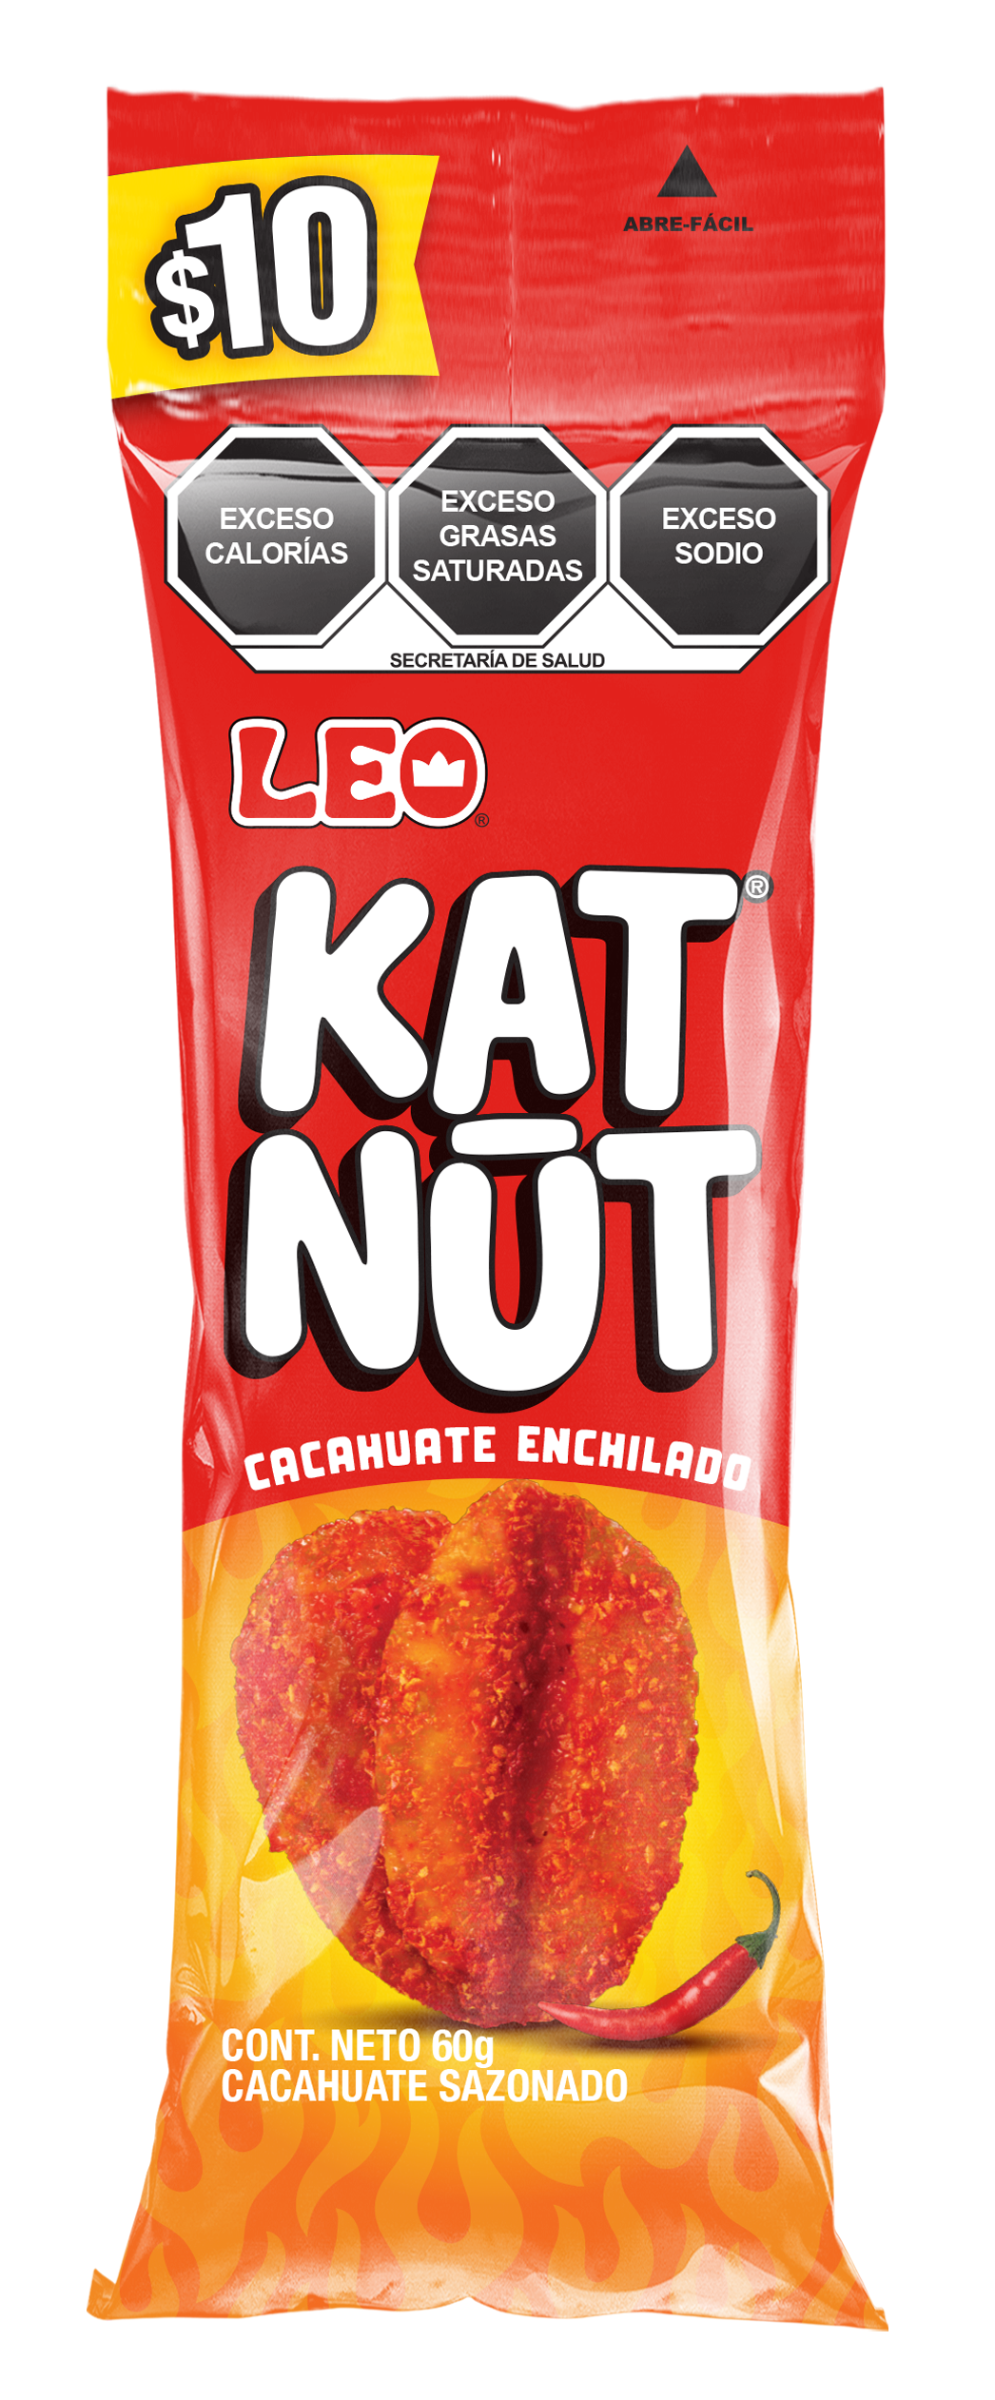
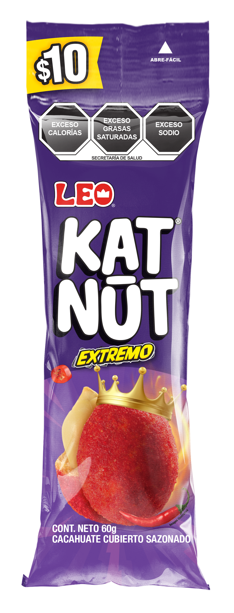
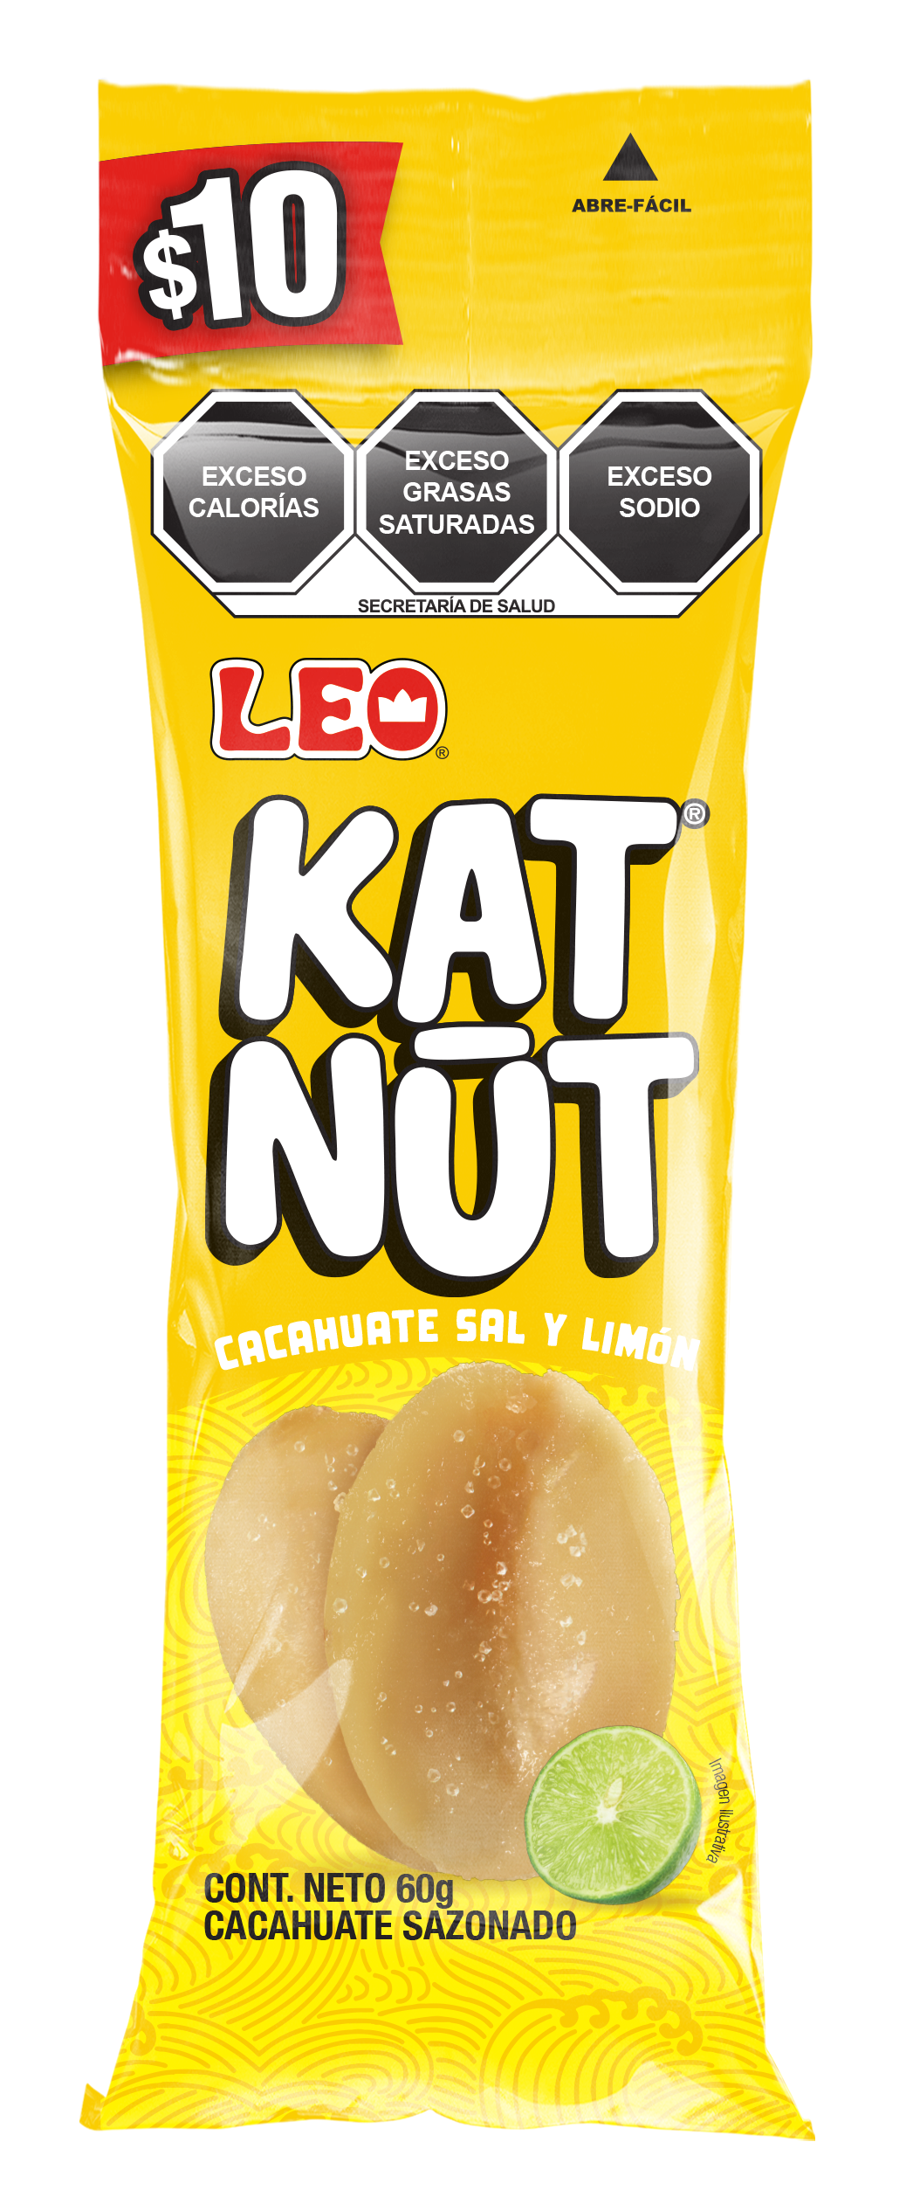
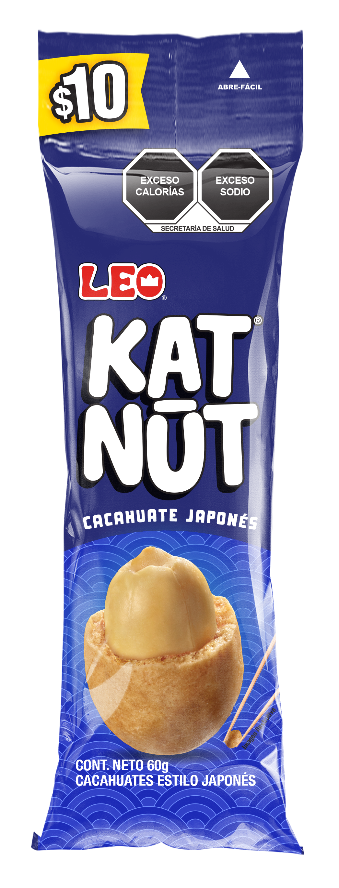
Kat nut enchilado 60.grs | Kat nut extremo 60.grs | Kat nut salado 60.grs | Kat nut japones 60.grs
$8.43 | $8.43 | $8.43 | $8.43

Slide 6
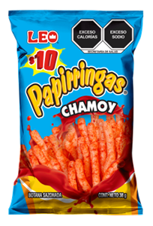
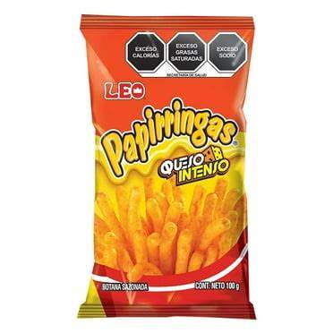
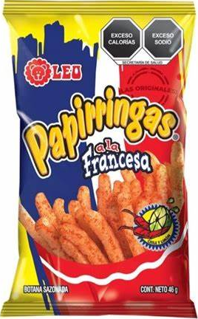
Papirringa chamoy 38.grs | Papirringa queso 38.grs | Papirringa 38.grs 100grs
$8.43 | $8.43 | $8.43 $23.59

Slide 7
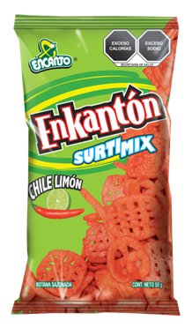
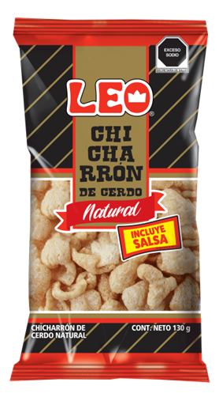
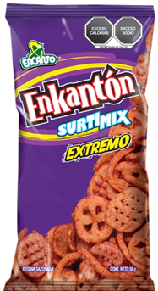
Enkanton 60.grs 155.grs | Chicharron 130.grs | Enkanton piccas 60.grs
$8.43 $35.38 | $46.34 | $8.43

Slide 8
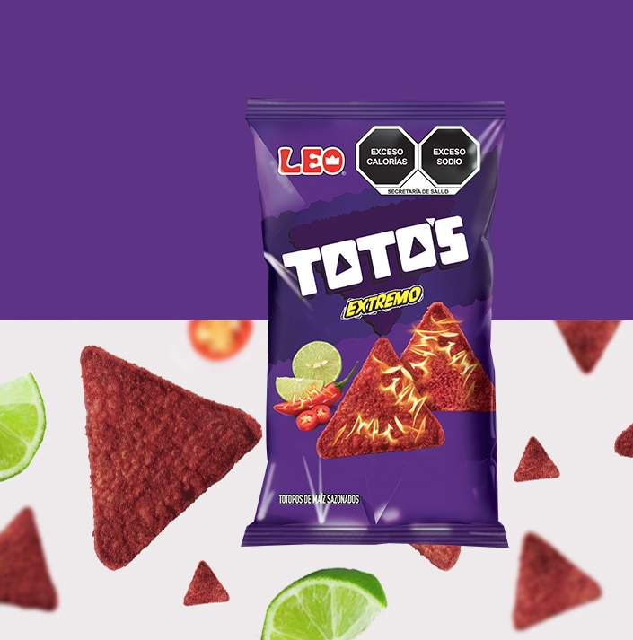
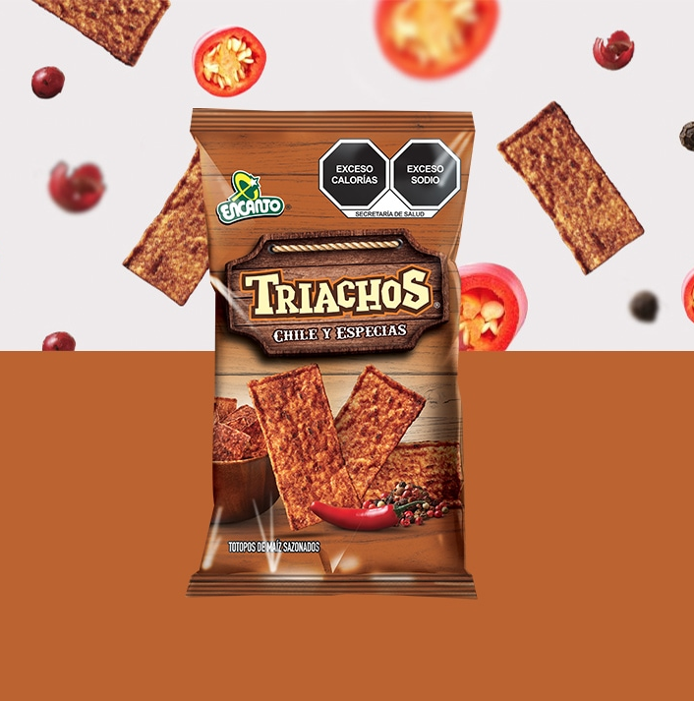
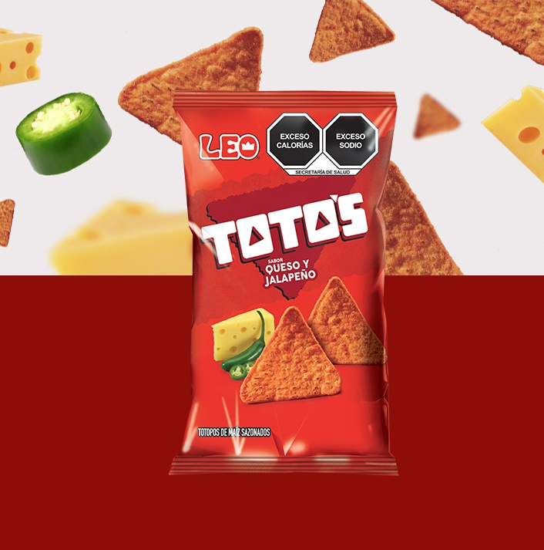
Toto extremo 46.grs 70.grs | Triacho 46.grs 70.grs | Toto queso 46.grs 70.grs
$8.43 $12.64 | $8.43 $12.64 | $8.43 $12.64

Slide 9
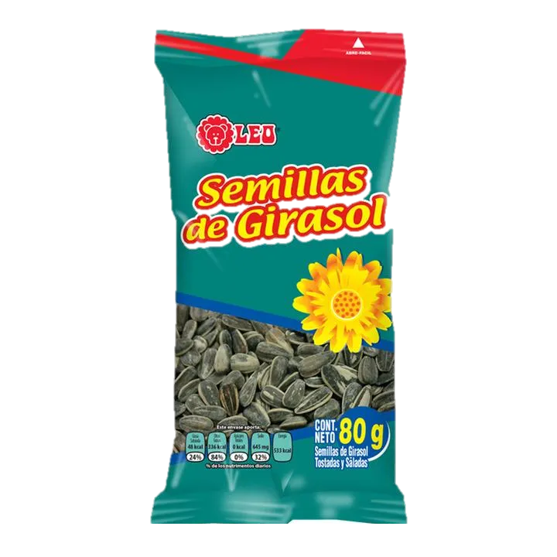
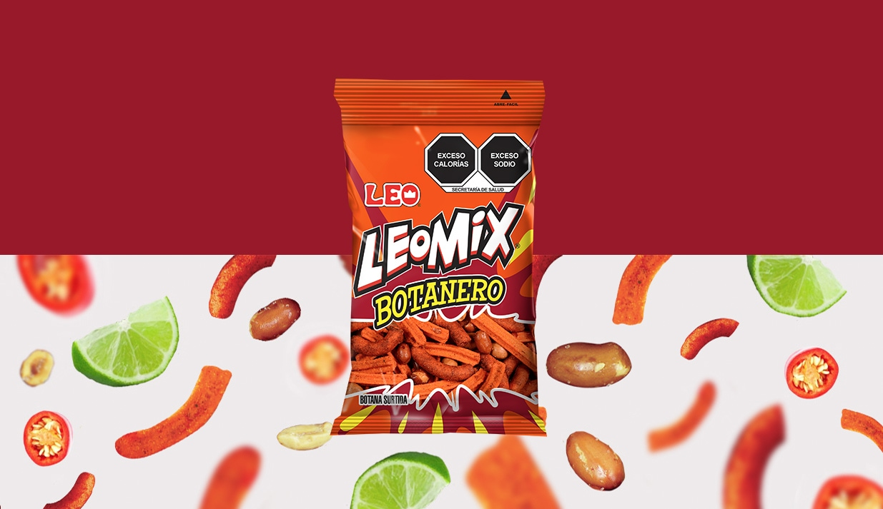
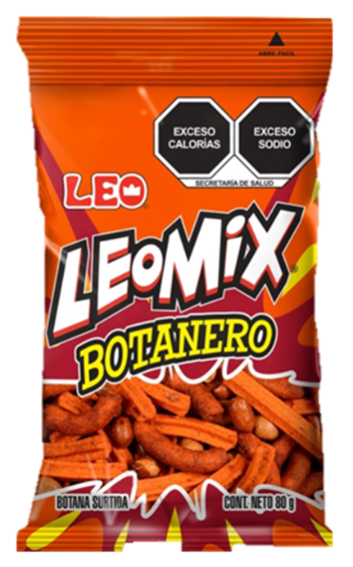
Leomix botanero 90.grs | Semilla de girasol 70.grs
$12.64 | $12.64

